Slide 1

Battles of the Revolutionary War

Slide 2

Battle of Lexington & Concord
1775
This was the first battle of the Revolutionary War
Paul Revere warned the colonists that the British were coming to Concord.
Minutemen were waiting in Lexington for the soldiers.
Minutemen were militia with special training.
No one knows whether the British or the colonists fired the first shot
Eight colonists died and nine were wounded.
Only one British solider was hurt.
The British continued marching to Concord.
Colonists and British started shooting at each
other.
As the British marched back to Boston,
thousands of minutemen shot at them.
The British were then trapped in Boston.

Slide 3
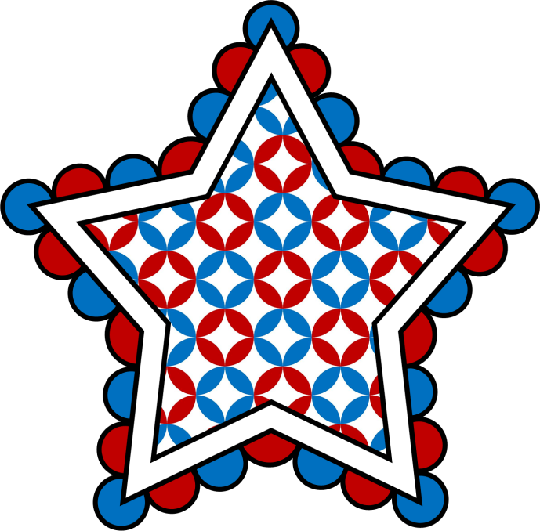
Battle of Bunker Hill
Militia leaders decided to build a fort on
Bunker Hill because they could fire
cannons from the hill at the British
soldiers.
The hill made it difficult for soldiers to attack them.
Instead of Bunker Hill though, they actually decided to build the fort on Breed’s Hill.
They did this because it was closer to Boston.
Each time the British attacked the Patriots, they were forced back and more than half of their soldiers were killed or wounded.
Then, the Patriots ran out of gunpowder and the British captured the fort and won the battle.
This battle however proved that they could fight well.

Slide 4

Battle of Trenton
Washington was asked to be the leader of the Continental Army.
His army was getting smaller, and he was worried that his soldiers would give up.
George Washington planned a surprise attack on an enemy camp in Trenton, New Jersey.
The soldiers in Trenton were German mercenaries which are soldiers who are paid to fight for a foreign country.
Washington took his soldiers across the
Delaware River to New Jersey and
attacked Trenton the day after
Christmas.
Washington’s army took almost 1,000
prisoners.
This was a victory for the Patriots.

Slide 5

Battle of Saratoga
The British were going to attack from Canada, so an army of Americans prepared to stop them near Saratoga, New York.
They set up a wall of dirt and logs on a hill so they could fight behind it.
The Americans won the battle.
This was a turning point in the war because France joined the war against British to help the Americans.
They sent money, soldiers, and a powerful navy to help.
Spain, the Netherlands, and Russia also joined the Americans to fight against Britain.

Slide 6

Winter at Valley Forge
American soldiers were
suffering at Valley Forge
due to the cold weather.
Many soldiers died of disease
because they went barefoot, slept on the frozen ground, and food was limited.
Washington worked hard to keep his army going and worked hard to get supplies.
His soldiers ended up eventually having more food and better uniforms to wear.
By the time it was spring, the army was ready to fight again.

Slide 7

Battle of Yorktown
Yorktown is located on a peninsula between the York and James Rivers.
Americans and French fired cannons at the British.
The French Navy blocked Yorktown harbor, so the British ships could not rescue their troops.
Due to Yorktown’s location, the British were trapped.
The British army surrendered which means they gave up at Yorktown.
This was the last big battle of the War for
Independence.
The war continued for about 2 years, but
not a lot of fighting occurred.
The Americans had won their independence
and won the war.
1781-1783

Slide 8
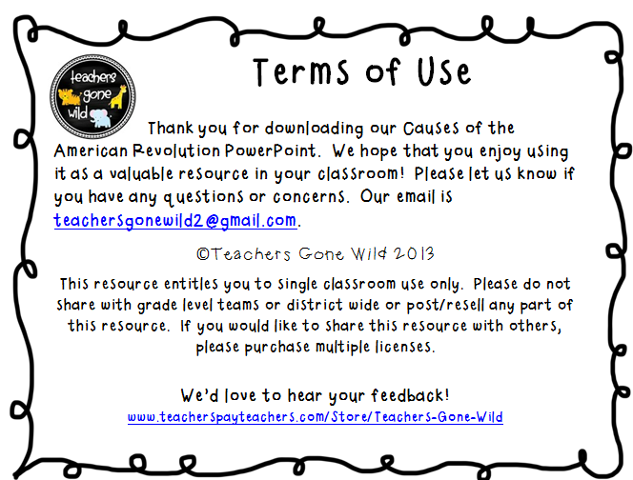
My Battles of the
I
me
My
© Kara Lee 2013
I’d

Slide 9
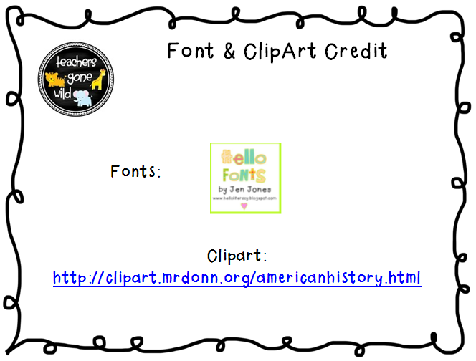
http://www.teacherspayteachers.com/Store/Ashley-Hughes-38
Backgrounds:
http://www.teacherspayteachers.com/Store/The-Candy-Class

